Slide 1
The Pursuit of Hoppiness
Presented by: Hannah Kosinovsky, John Yan, & David Nguyen

Slide 2
Introduction
We analyzed the provided data to determine:
What state would be the best to open a new brewery?
What type of beer should it brew?

Slide 3
How many breweries are present in each state?

Slide 5
What are the first six observations of the merged beer and breweries data?

Slide 6
First Six Observations
Brewery ID | Beer Name | Beer ID | ABV | IBU | Style | Ounces | Brewery Name | City | State
1 | Get Together | 2692 | 0.045 | 50 | American IPA | 16 | NorthGate Brewing | Minneapolis | MN
1 | Maggie’ Leap | 2691 | 0.049 | 26 | Milk / Sweet Stout | 16 | NorthGate Brewing | Minneapolis | MN
1 | Wall’s End | 2690 | 0.048 | 19 | English Brown Ale | 16 | NorthGate Brewing | Minneapolis | MN
1 | Pumpion | 2689 | 0.060 | 38 | Pumpkin Ale | 16 | NorthGate Brewing | Minneapolis | MN
1 | Stronghold | 2688 | 0.060 | 25 | American Porter | 16 | NorthGate Brewing | Minneapolis | MN
1 | Parapet ESB | 2687 | 0.056 | 47 | Extra Special / Strong Bitter (ESB) | 16 | NorthGate Brewing | Minneapolis | MN

Slide 7
What are the last six observations of the merged beer and breweries data?

Slide 8
Last Six Observations
Brewery ID | Beer Name | Beer ID | ABV | IBU | Style | Ounces | Brewery Name | City | State
556 | Pilsner Ukiah | 98 | 0.055 | NA | German Pilsener | 12 | Ukiah Brewing Company | Ukiah | CA
557 | Heinnieweisse Weissebier | 52 | 0.049 | NA | Hefeweizen | 12 | Butternuts Beer and Ale | Garrattsville | NY
557 | Snapperhead IPA | 51 | 0.068 | NA | American IPA | 12 | Butternuts Beer and Ale | Garrattsville | NY
557 | Moo Thunder Stout | 50 | 0.049 | NA | Milk / Sweet Stout | 12 | Butternuts Beer and Ale | Garrattsville | NY
557 | Porkslap Pale Ale | 49 | 0.043 | NA | American Pale Ale (APA) | 12 | Butternuts Beer and Ale | Garrattsville | NY
558 | Urban Wilderness Pale Ale | 30 | 0.049 | NA | English Pale Ale | 12 | Sleeping Lady Brewing Company | Anchorage | AK

Slide 9
What is the number of NA's in each column?

Slide 10
Number of NA’s in each Column
Brewery ID | Beer Name | Beer ID | ABV | IBU | Style | Ounces | Brewery Name | City | State
0 | 0 | 0 | 62 | 1005 | 0 | 0 | 0 | 0 | 0

Slide 11
What is the median alcohol content (ABV) for each state?

Slide 12
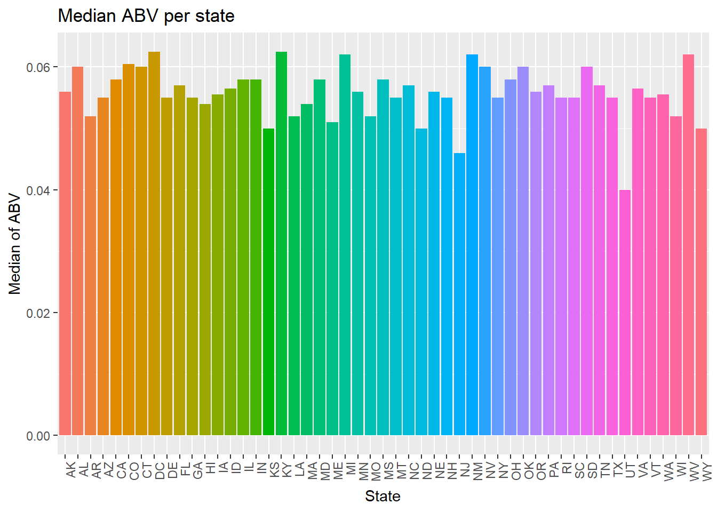

Slide 13
What is the median international bitterness unit (IBU) for each state?

Slide 14
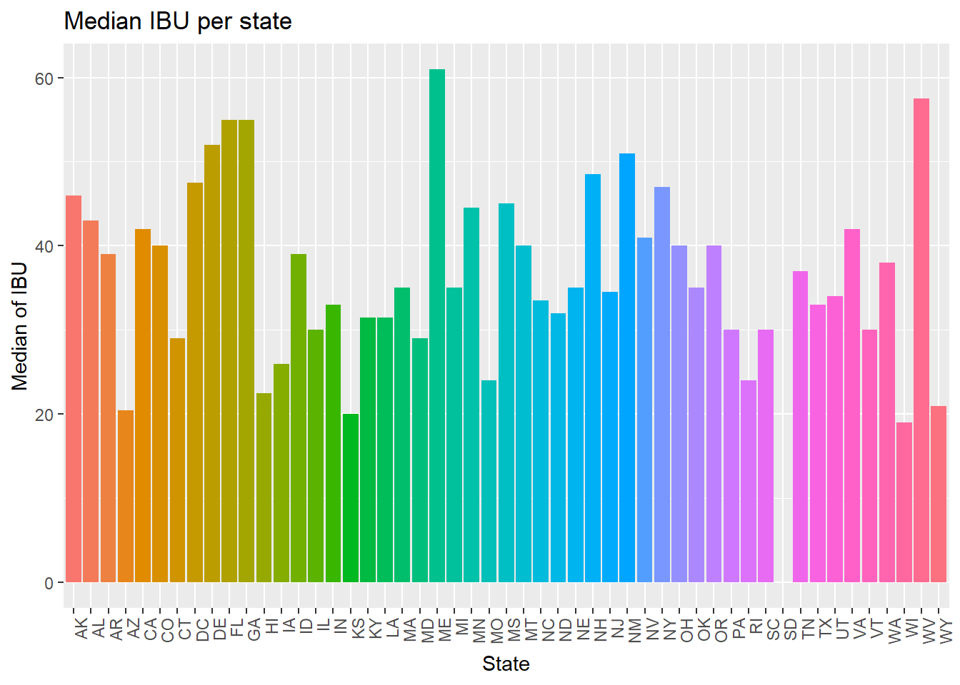

Slide 15
Which state has the maximum alcoholic (ABV) beer?

Slide 16
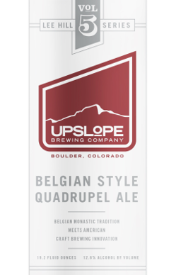
Colorado
Colorado has the maximum alcoholic (ABV) beer at 0.128 for Lee Hill Series Vol. 5 – Belgian Style Quadrupel Ale.

Slide 17
Which state has the most bitter (IBU) beer?

Slide 18
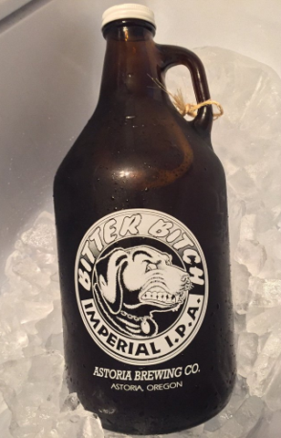
Oregon
Oregon has the most bitter (IBU) beer at 138 for 3745 Bitter Bitch Imperial IPA.

Slide 19
What are the summary statistics for ABV?

Slide 20
Summary Statistics for ABV
Mean | Max | Min | Median | Std
0.05977342 | 0.128 | 0.001 | 0.056 | 0.01354173

Slide 21
Is there an apparent relationship between ABV and IBU?

Slide 22
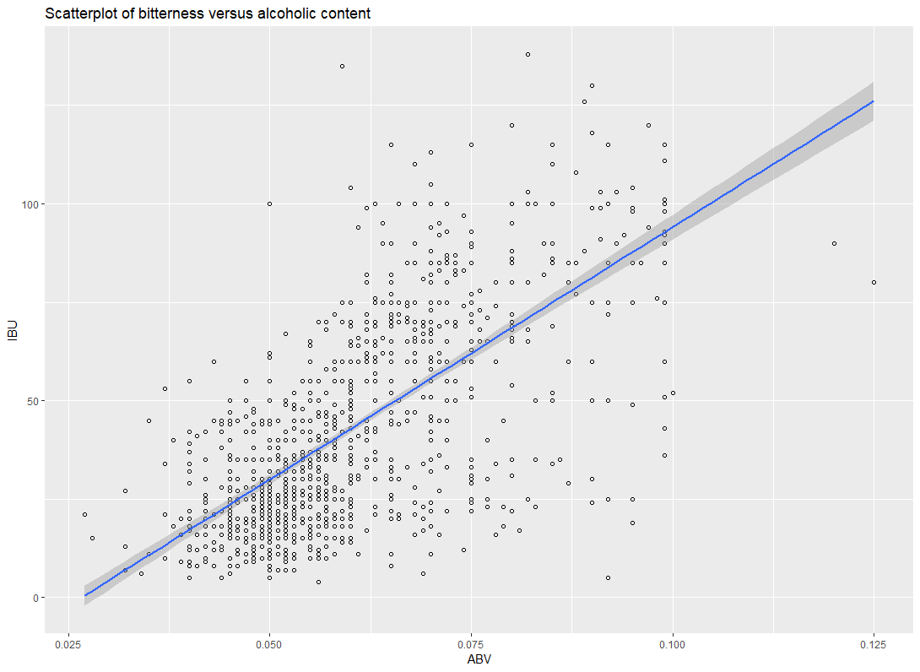
The correlation coefficient is 0.67 and that indicates a positive strong relationship between the two variables.

Slide 23
What is the Arkansas beer market like?

Slide 24
Arkansas Beer Market
Brewery | Beer | ABV | IBU
Core Brewing & Distilling Company | Core ESB | 0.061 | N/A
Core Brewing & Distilling Company | Core Oatmeal Stout | 0.057 | N/A
Core Brewing & Distilling Company | Arkansas Red | 0.052 | N/A
Core Brewing & Distilling Company | Behemoth | 0.05 | N/A
Ozark Beer Company | Ozark American Pale Ale | 0.04 | 39

Slide 25
Conclusion
We can conclude from the analysis that:
Arkansas would be the best state to open a new brewery because it has a population of 3 million and only 2 breweries.
Since the 2 breweries offer beers with low alcohol and bitter content, the new brewery should offer beer with higher alcohol and bitter content to fill that niche/void.

